Slide 1
CS-Studio: An Introduction

Slide 2
What is cs-studio:

Slide 3
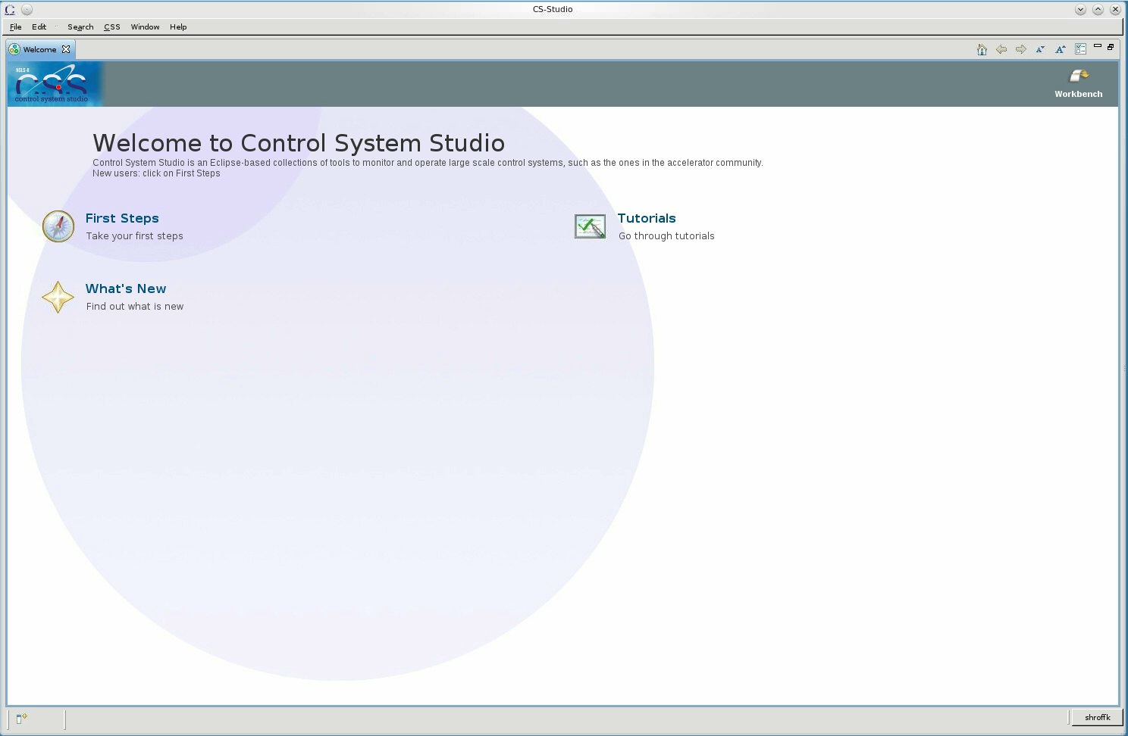
Demo

Slide 4
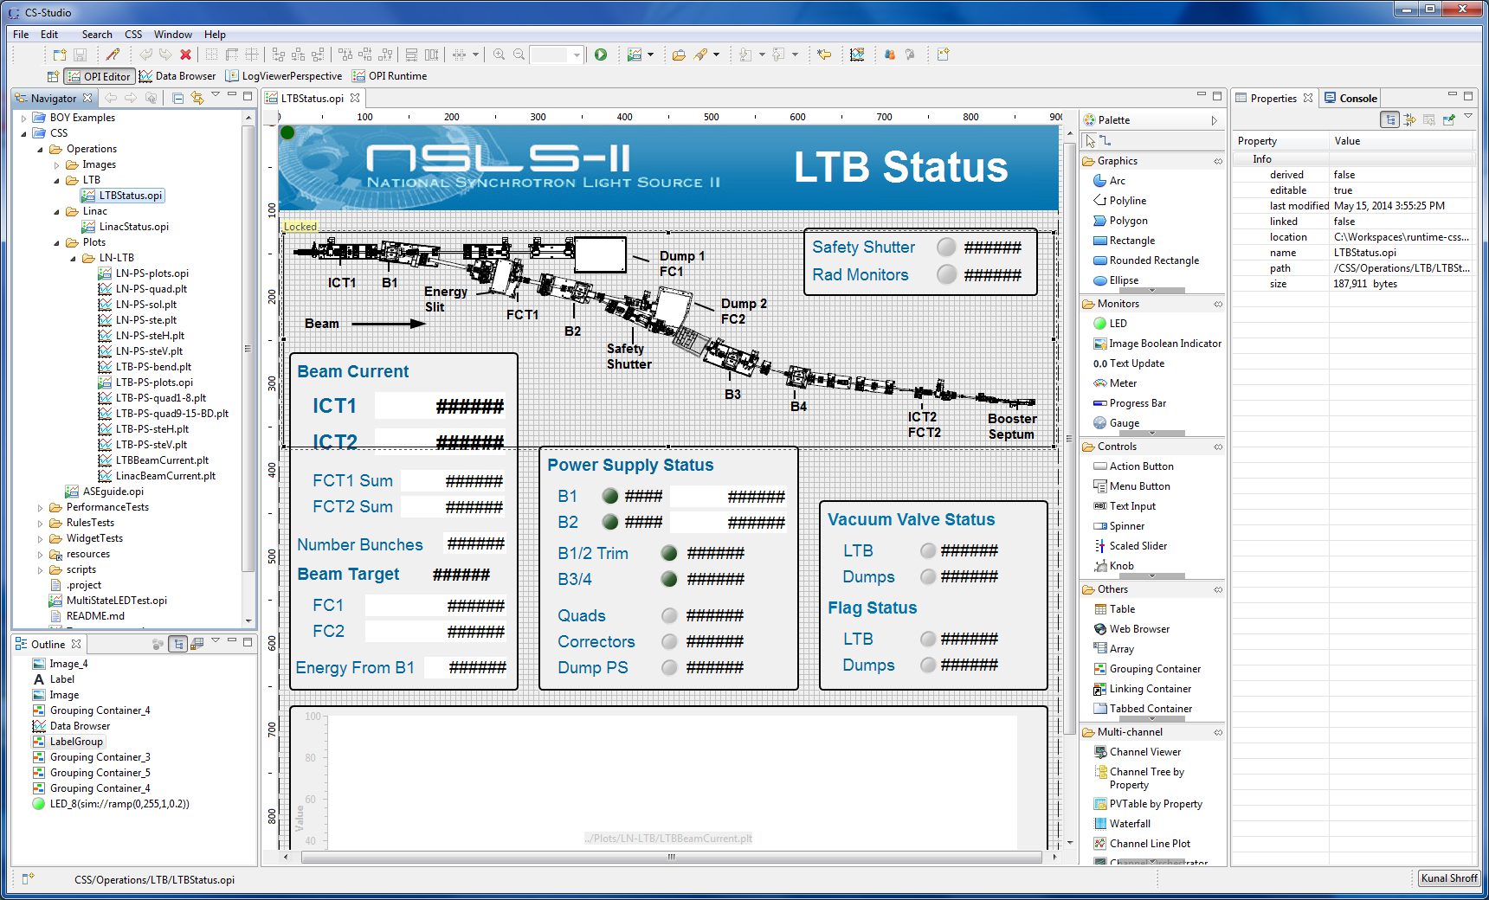
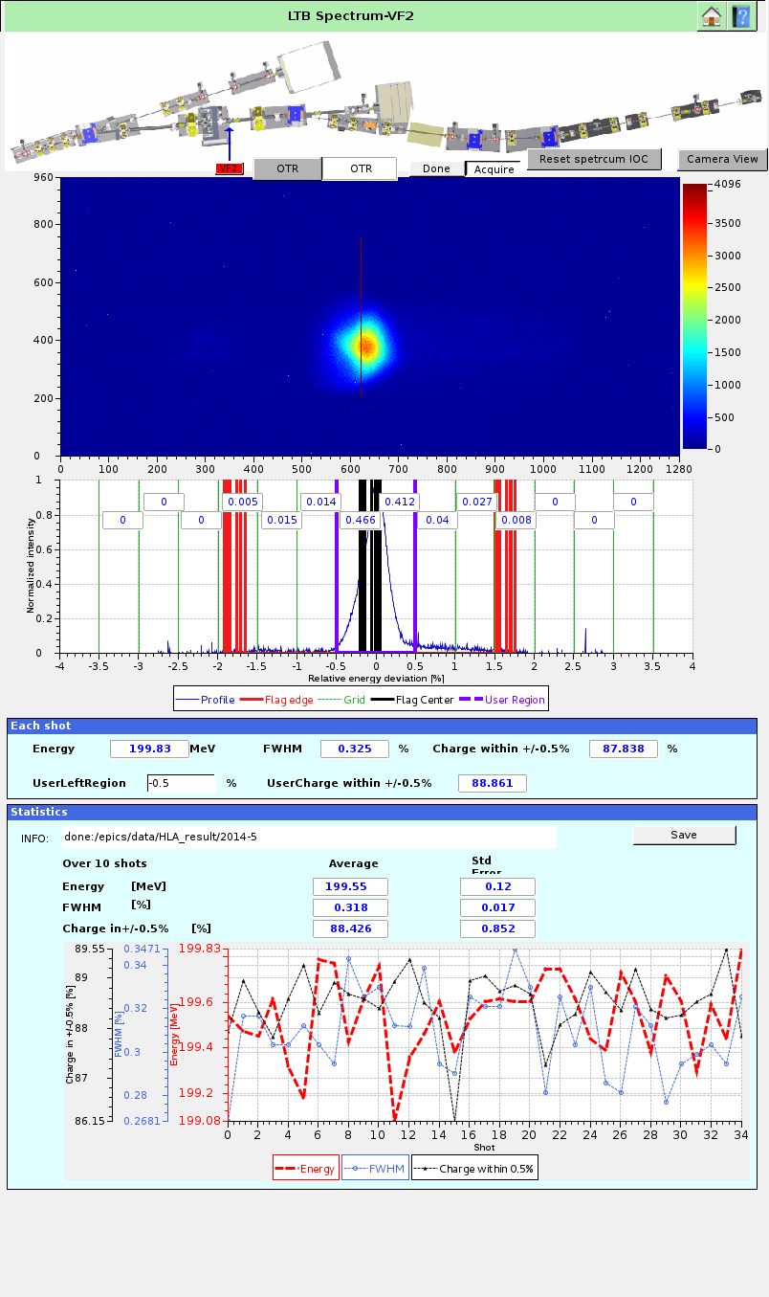
OPI editor and run environment

Slide 5
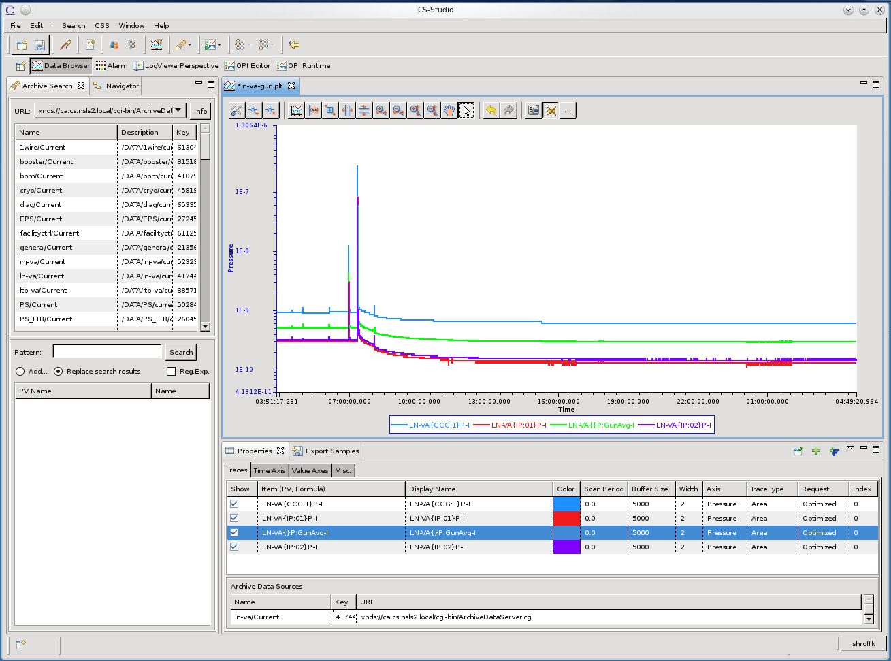
Viewer for Historic data

Slide 6
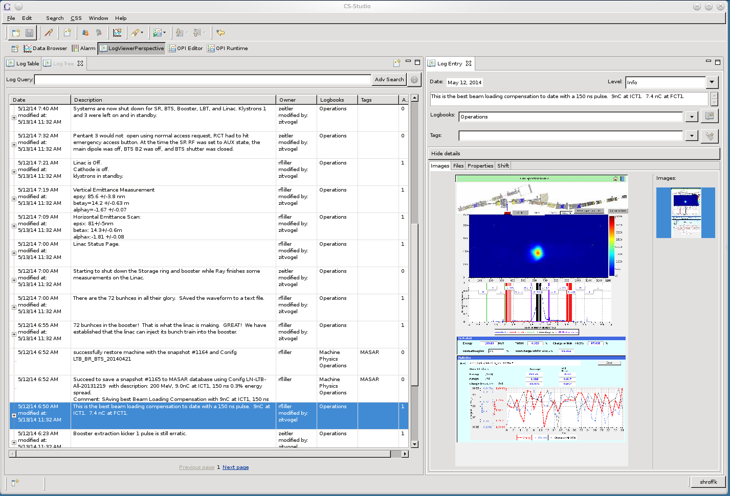
Log Viewer

Slide 7
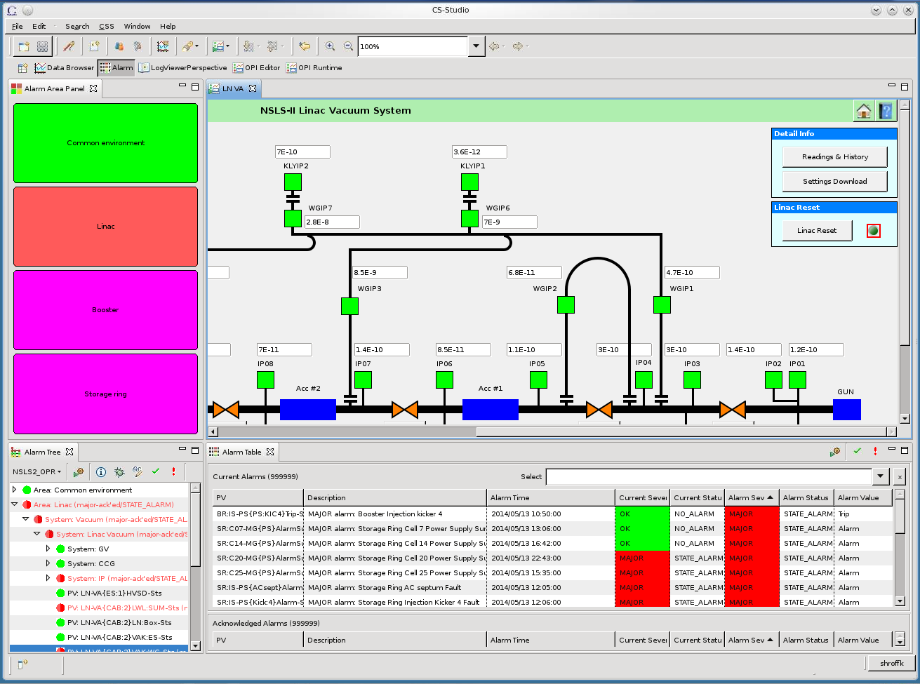
Alarm Viewer

Slide 8
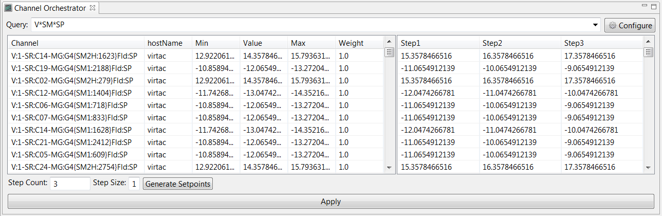
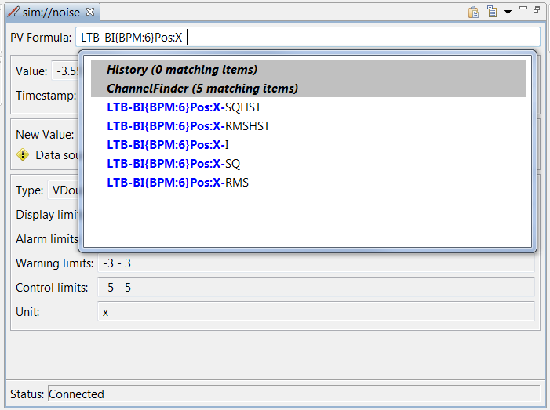
ChannelFinder

Slide 9
A Integrated set of tools
Control Systems (epics v3, v4)
BOY, probe, pvtable
Epics services
Alarms, Archiver, Save Restore
Utility Services
Logbook, Channel Directory, Shift
Physics services
Lattice, unit conversion

Slide 10
Publish/subscribe
v3
v4
IOC
IOC
…
IOC
IOC
…
CSS core
CS-Studio
General purpose clients
CA client (JCA/CAJ)
pvA client
BOY
DataBrowser
Command/response
Core Java Client
…
v4
ca
pva
…
Data Sources
Masar
API
pvmanager core
Aggregation
vTypes
Data Definition
…
…
NEW!
Specialized clients
formula
Processing
Log Viewer
graphene
Visualization
AccelUtils
NEW!
Channel Viewer
pvm services
Registry
Web based REST services
masar
cf
…
Bindings
…
ChannelFinder
API
Olog
API
WebUI, scripts, other client
Logbook
...
…
cf-update
...

Slide 11
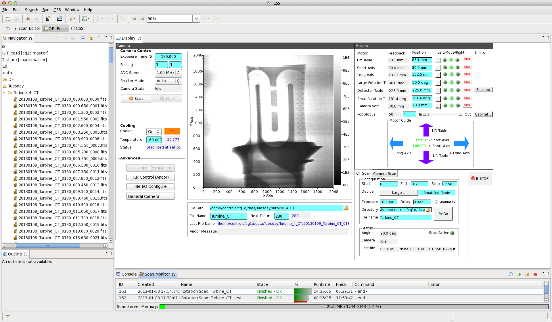
ORNL ‘CG-1D’ Beam Line
Neutron Tomography, EPICS/CSS since Jan. 2013
Kay Kasemir, USPAS2014

Slide 12
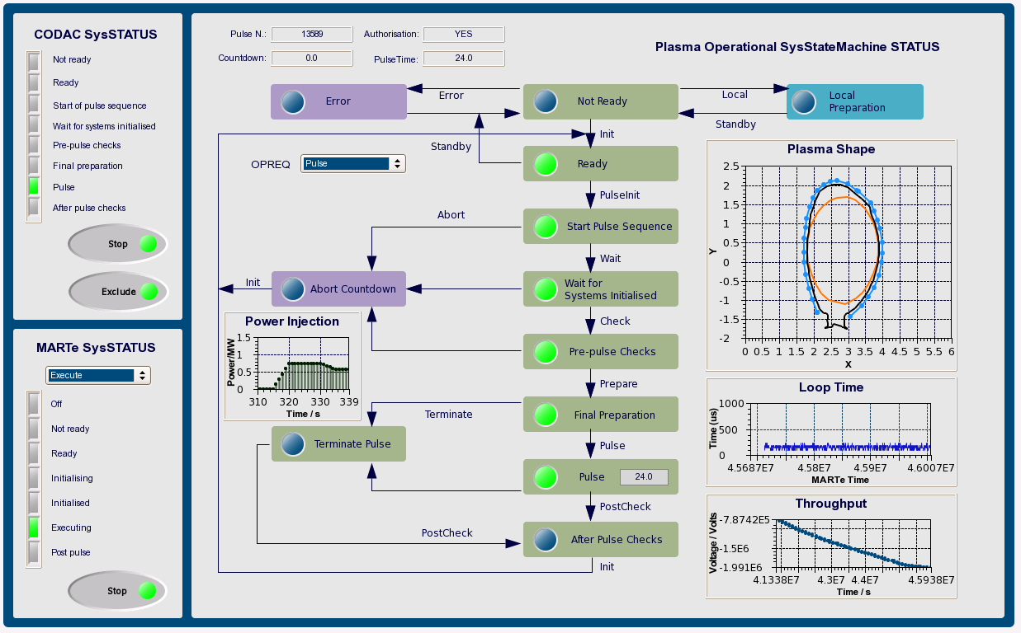
ITER-FPSC-vBetaVersionPanelsOPI
Neutron Tomography, EPICS/CSS since Jan. 2013
-UserManual.doc, Nadine Utzel, 2011

Slide 13
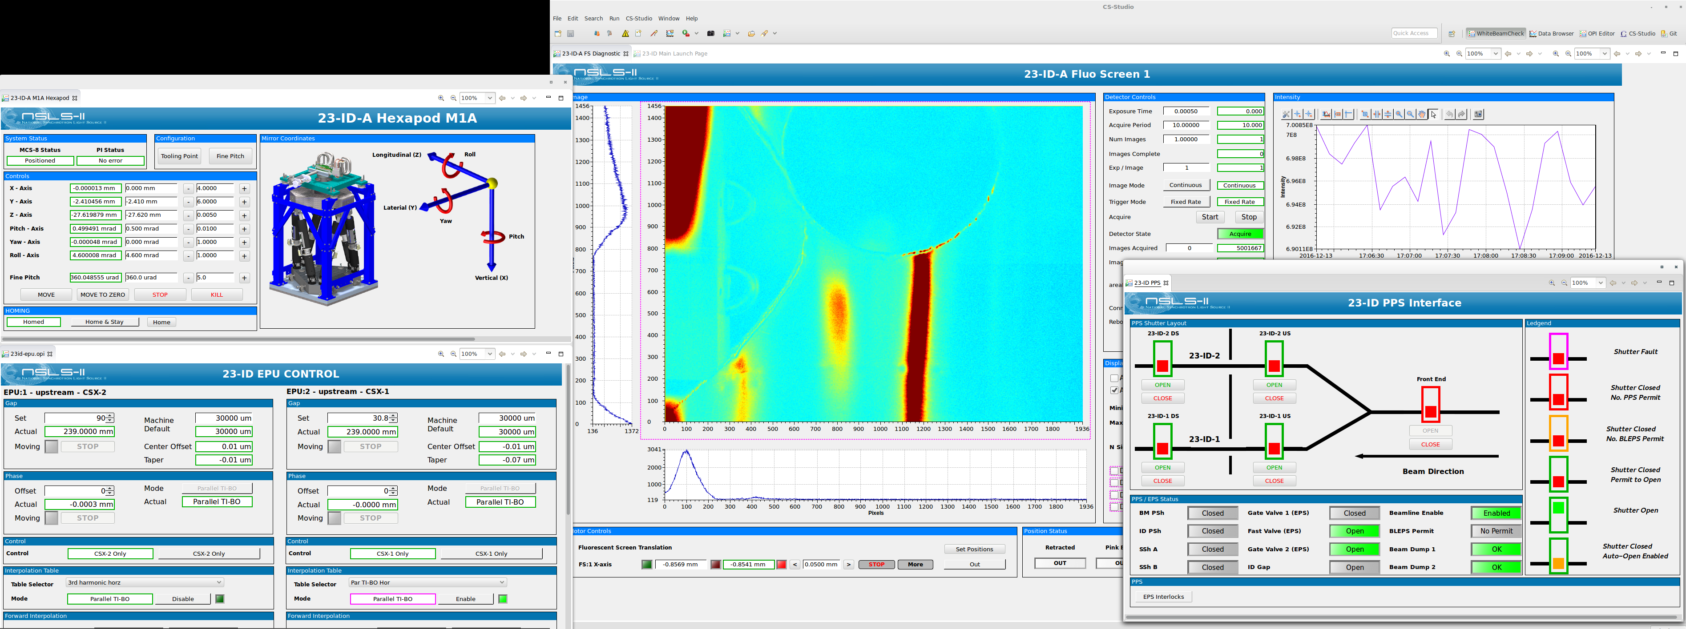
NSLSII XF23 Beam Alignment

